Slide 1

Fundamentals
SOFTWARE QUALITY ASSURANCE (SQA)

Slide 2

SQA
What you will learn Today
High level Introduction of Software Testing and required skills
Start performing functional testing on Sample application
Introduction
2

Slide 3

SQA
Table of Content
Introduction To Software Testing
Who are Software Testers
Overview of Applications and Systems
Getting Started with Functional Testing
Lab Exercise
Introduction
3

Slide 4

SQA
Introduction to Software Testing
4

Slide 5
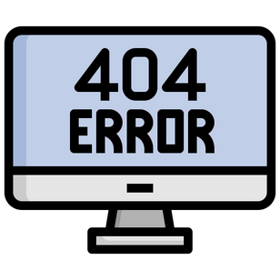
SQA
Seen any software failures in real life?
A smartphone mapping app showed a museum in middle of river – A basic functionality failure
Ariane 5 crashed 40 sec after takeoff because of incorrect calculation by its inertial reference system that was taken from Ariane 4 – An incompatible component reuse
UK’s top 10 most wanted criminals went down due to un-expected issue – A performance failure
A change in billing system of an electrical provider blacked out a city – An upgrade failure
A wide area blacked-out due to a hacking incident occurred in Ukraine – A security failure
Why testing is important?
5

Slide 6
SQA
🢇
So software can fail because of different types of issues functional,performance,security, integration,upgrade process, etc
Why testing is important?
6

Slide 7
SQA
Mistake/Error
Why do failures happen?
Humans are prone to making Mistakes
Failures
Event when a user experiences a problem
Fault
A failure is caused by a fault in software
Error
The cause of fault is an error or mistake by a person
Why testing is important?
Defect/Fault/Bug
Failure
7

Slide 8
SQA
Causes of failures
System Complexity
Deadlines Pressure
Organizational Limitations/Issues
Resource Capabilities
Limitations of knowledge available at that time
Algorithms limitations
Misunderstanding requirements
Typing Mistakes
Why testing is important?
8

Slide 9
SQA
How to avoid or rectify?
Testing can contribute towards timely avoidance and rectification, if its well integrated with software development lifecycle
Why testing is important?
9

Slide 10
SQA
Basic Definitions
Process of software testing offers an opportunity to discover any errors in the product under test
It’s a systematic exploration of a component/system with the main aim of finding and reporting defects
What is Software Testing
10

Slide 11
SQA
Typical Objectives
To prevent defects by evaluate work products such as requirements, user stories, design, and code
To verify whether all specified requirements have been fulfilled
To check whether the test object is complete and validate if it works as the users and other stakeholders expect
To build confidence in the level of quality of the test object
To find defects and failures by reducing the level of risk of inadequate software quality
To provide sufficient information to stakeholders to allow them to make informed decisions, especially regarding the level of quality of the test object
To comply with contractual, legal, or regulatory requirements or standards, and/or to verify the test object’s compliance with such requirements or standards
What is Software Testing
11

Slide 12
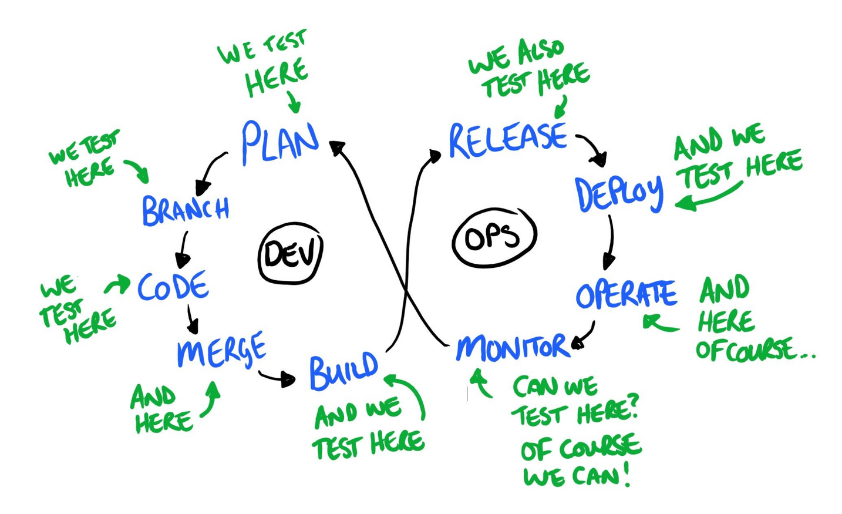
SQA
When do we test?
What is Software Testing
12

Slide 13
SQA
Requirement Analysis
Test Planning and Control
Basic Testing Process
Test Analysis and Design
We will be discussing these in details. Starting with Test implementation and execution
What is Software Testing
Test Implementation and Execution
Evaluating Exit Criteria and Reporting
Test Closure Activities
13

Slide 14
SQA
Testing, Quality Control and Quality Assurance
Testing
Attempts to find bugs
Quality Control
Attempts to built software systems and test it thoroughly
Quality Assurance
Enforce standards and techniques to improve process and prevent faults
Monitors and guides throughout the SDLC to improve software engineering practices
Common Terminologies
14

Slide 15
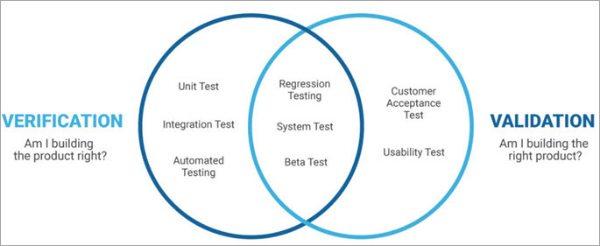
SQA
Verification and Validation
Verification
Confirmation by examination and through provision of objective evidence that specified requirements for each phase of SDLC have been fulfilled
Validation
Confirmation by examination and through provision of objective evidence that the requirements for a specific intended use or application have been fulfilled.
Common Terminologies
15

Slide 16
SQA
Static and Dynamic Testing
Static Testing
Testing of a software development artifact, e.g., requirements, design or code, without execution of these artifacts, e.g., reviews or static analysis
Dynamic Testing
Testing that involves the execution of the software of a component or system.
Common Terminologies
16

Slide 17
SQA
Who are Software Tester
17

Slide 18
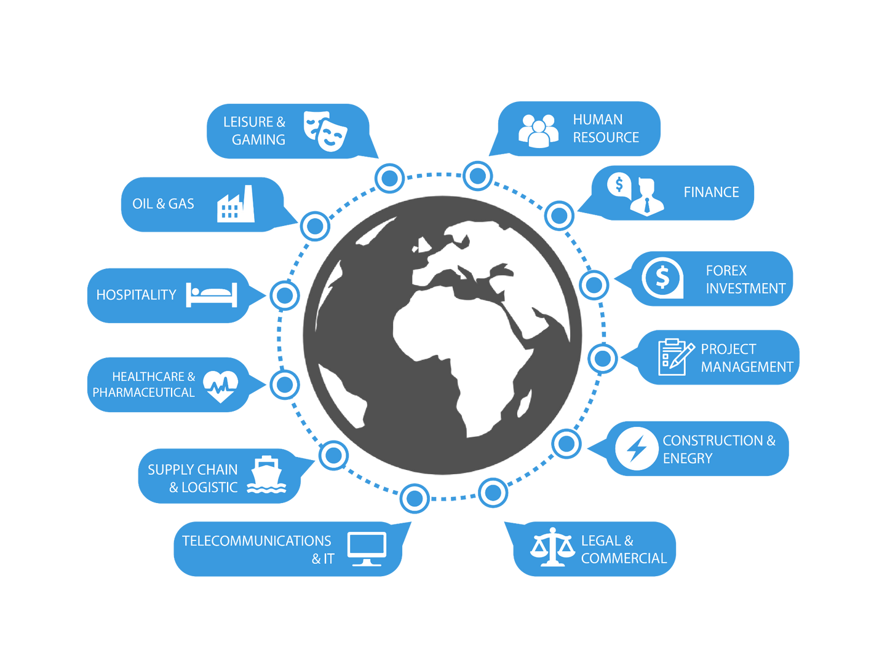
SQA
Technical Skills
Domain knowledge required for better testing
18

Slide 19
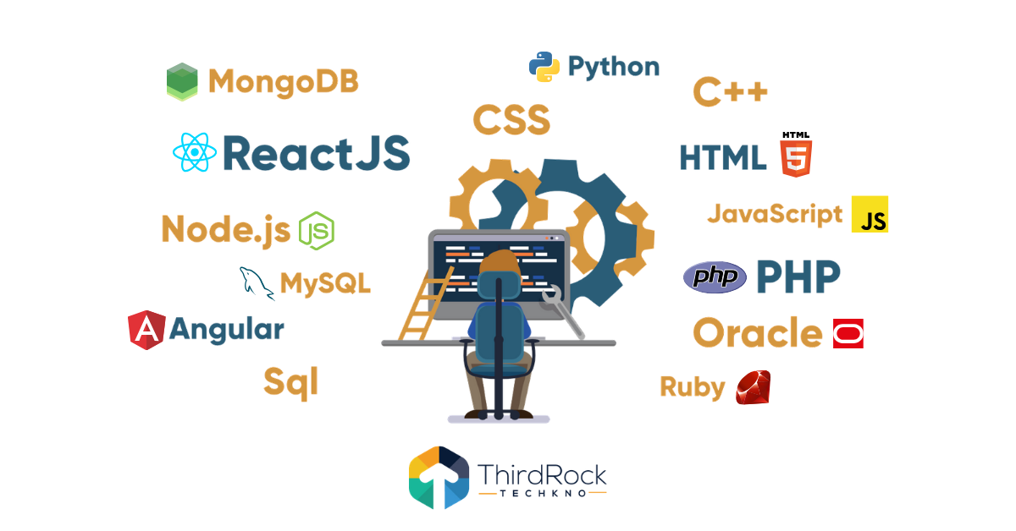
SQA
Technical Skills
Tech stack knowledge required for QA
To optimize testing strategies and tools
19

Slide 20
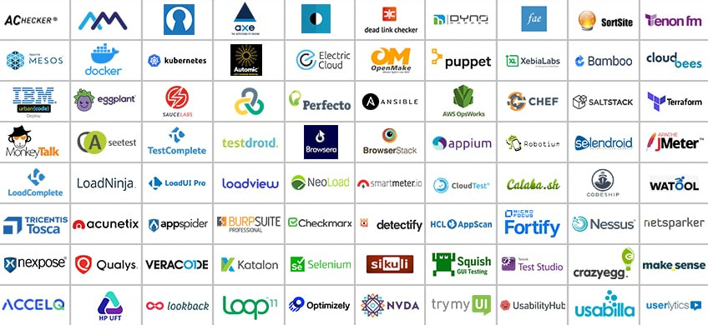
SQA
Technical Skills
Understanding of available tools for QAs
20

Slide 21
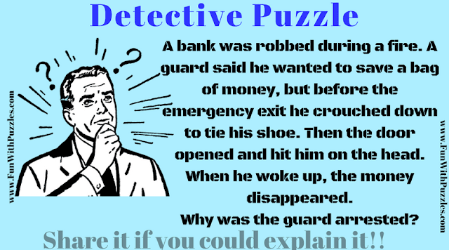
SQA
Soft Skills
Good Analytical skills
Detailed oriented and ability to put himself in shoes of multiple users
21

Slide 22

SQA
SQA Puzzle
A designer developed the color coding as shown on left for a health system that was to be installed in hospitals for patients use.
QA rejected the design. Why?
Soft Skills
Good Analytical skills
Detailed oriented and ability to put himself in shoes of multiple users
22

Slide 23
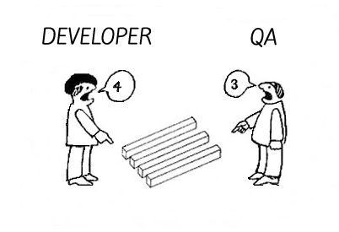
SQA
Soft Skills
Good Communication skills
Understanding yet persuasive
23

Slide 24
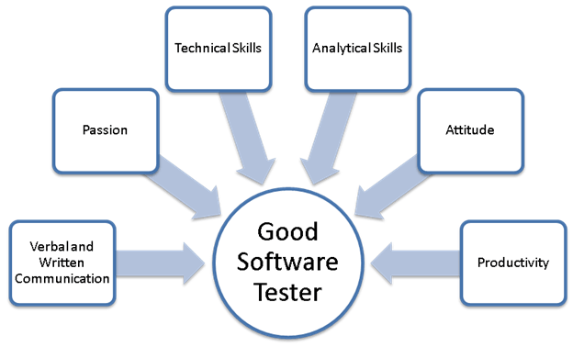
SQA
Soft Skills
A Good software tester
24

Slide 25
Exercise
Functional Testing
What do you understand of completeness, correctness and appropriateness of Software functional requirement
Can you identify any gap(s) in following requirements
You are building a solar system rental solution that will be rented to needy/elderly people living in rural areas of Pakistan. The solution is tech-driven and therefore the solution consists of a mobile app. That first release, monthly billing, payments and notifications can only be done through mobile app. They will get in-app notifications for pending payments based on their usage. They can report any issues/complains through app. They will also be able to make payment through the mobile app. The solution In-app supports credit card payments only. Different usage and analytical data is sent from devices to central servers through GSM (mobile SIM).

Slide 26
SQA
Exercise
You feel that the performance of the website is slower on your mobile and you have reported the bug. But the performance seems fine when developers try to test on their machine. They are suggesting that the performance issue is because of your own mobile.
What would be your approach to follow up on this?
Functional Testing
25

Slide 27
SQA
Applications and Systems
26

Slide 28
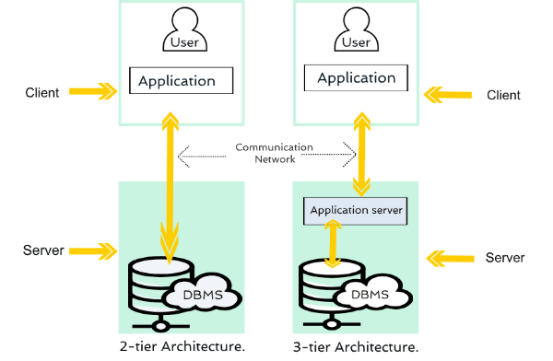
SQA
Web Applications
2-tire and 3-tier Architecture
27

Slide 29
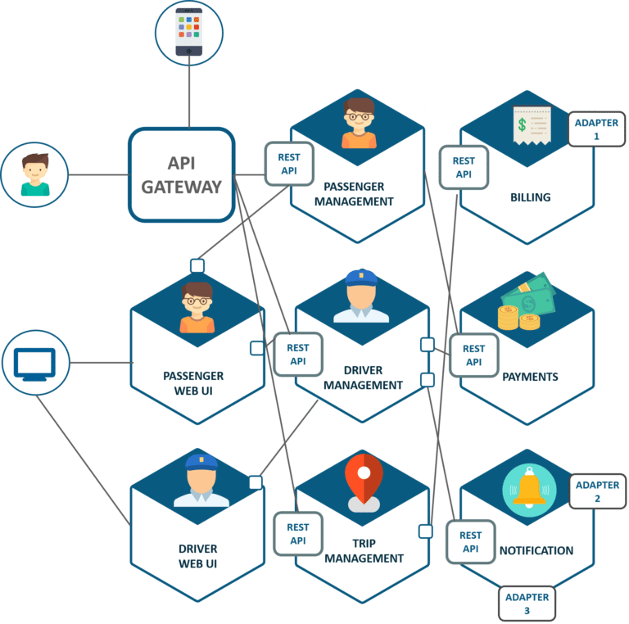
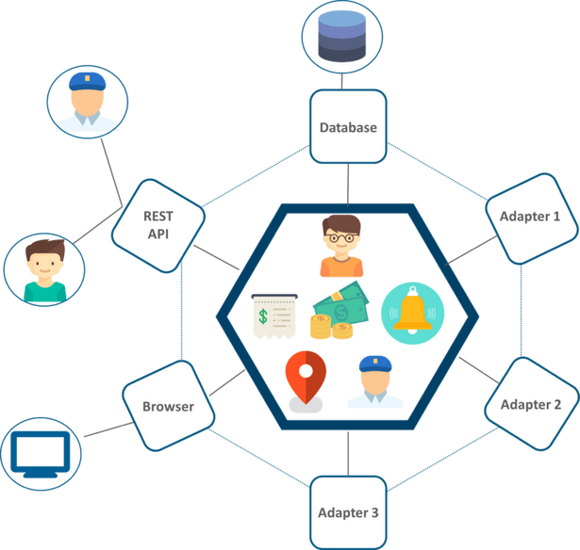
SQA
Web Applications
Monolithic vs Micro-service architecture
28

Slide 30
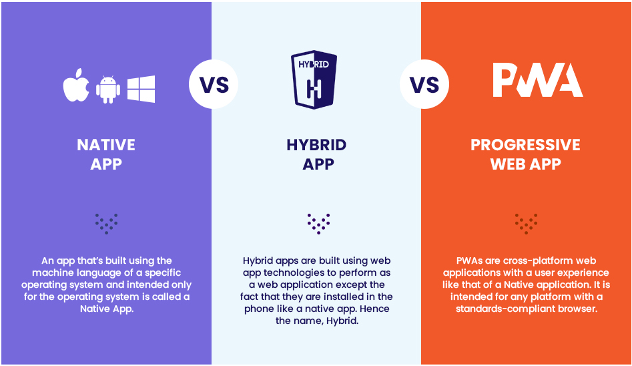
SQA
Mobile Applications
29

Slide 31
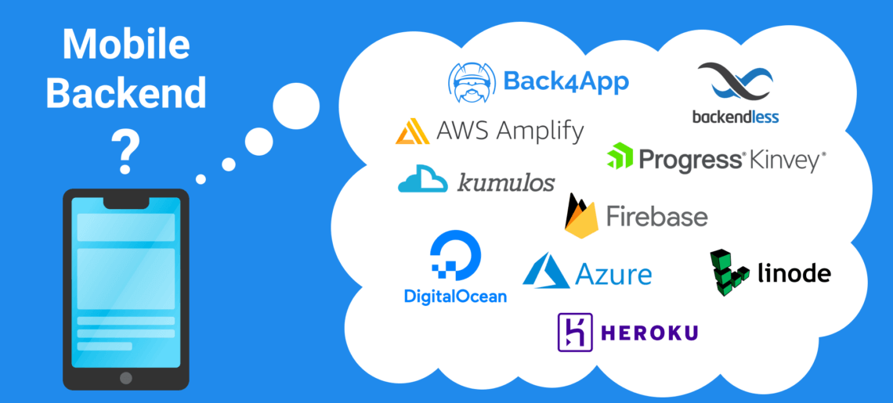
SQA
Mobile Applications
Mobile App with backend
App that dont need backend (calculator, compass, measurrr, etc.) vs App that need backend (Amazon, Creem, Netflix, etc.)
30

Slide 32
SQA
Getting Started with Functional Testing
31

Slide 33
SQA
Example of Functional Testing
List Size | Input set of integers | Expected Output (minimum value)
5 | 6, 9, 2, 16, 19
7 | 96, 11, 32, 9, 39, 99, 91
7 | 31, 36, 42, 16, 65, 76, 81
6 | 106,109,88,111, 114,116
6 | 61,69,99,31,21,69
2
Functional Testing
9
16
88
21
Are These Enough?
32

Slide 34
SQA
Other Possibilities
A very short list with size 1/2/3
An empty list
An element where the minimum is first or last element
A list where minimum element is negative
A list of all negative elements
A list with duplicate elements
A list that contains non numeric characters
A list where one element is greater than the maximum or minimum value
Functional Testing
33

Slide 35
SQA
Possible test scenarios for a login?
Field validations
Empty fields + Ok button
One valid + one empty + Ok button
Not allowed characters (if any) + Ok button
Greater than maximum allowed characters
Incorrect email format
Invalid entries
Invalid username and/or password
Valid credential for deleted/locked user
Old credentials for an updated password
Functional Testing
34

Slide 36
SQA
Possible test scenarios for a login?
Valid Entries
Valid User and password + any button other than Ok
Valid user and pass + ok
Valid credential for recently created user
New credential for recently updated password
Logout and login again
Login with remember me marked
Login with remember me unmarked
Functional Testing
35

Slide 37
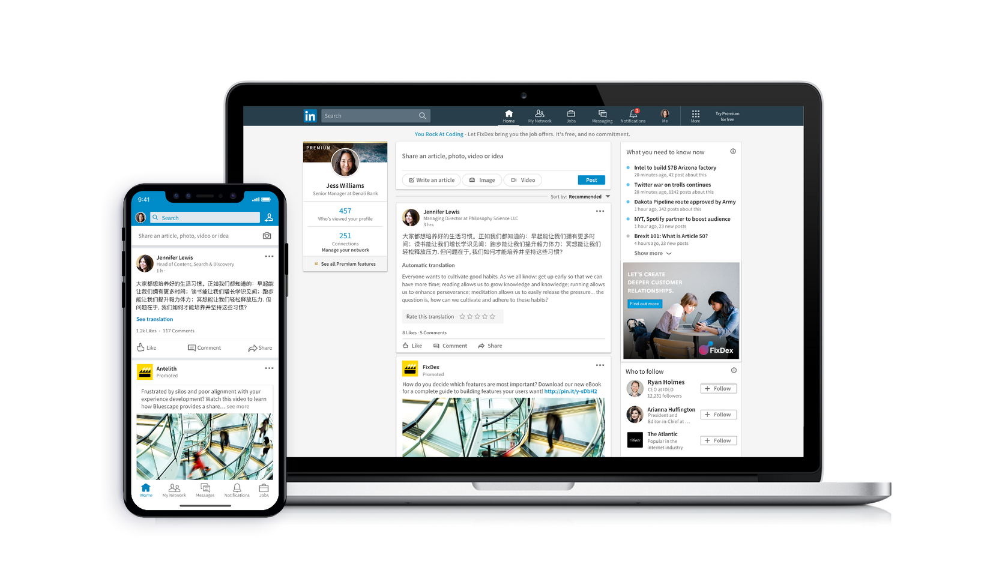
SQA
Exercise
Identify what you will test for messaging feature of Whatsapp?
Functional Testing
Identify what you will test for facebook/linkedin feed?
36

Slide 38
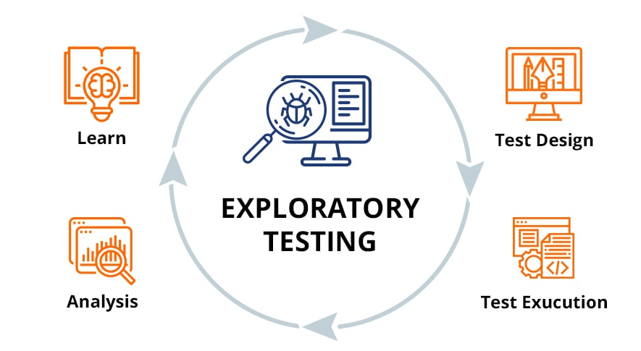
SQA
What to do when you are given an application for testing?
Learn and test at the same time
Exploratory Testing
37

Slide 39
SQA
Understand and Document Functionality
https://demo.vuestorefront.io/
https://thedemosite.co.uk/
What is Software Testing
38

Slide 40
SQA
Exercise
Identify functionalities of Whatsapp application?
Functional Testing
39

Slide 41
SQA
Reading Break and Exercise
40

Slide 42
SQA
Reading
https://istqb-main-web-prod.s3.amazonaws.com/media/documents/ISTQB-CTFL_Syllabus_2018_v3.1.1.pdf
1.1, 1.2, 1.5
https://iso25000.com/index.php/en/iso-25000-standards/iso-25010
https://www.linkedin.com/pulse/continuous-testing-devops-dan-ashby/
What is Software Testing
41

Slide 43
SQA
Q&A
Instructor Notes
42

